Slide 1
Back to school 2020-2021
Dr. Chaney

Slide 2
Ready to get started?
About Me
About this class
Expectations

Slide 3
About Me
I started teaching in Paulding County in 2004
I have been a teacher at EPHS since 2006
I have a Bachelor of Arts in Psychology from The University of Texas
I have a Master of Arts in Industrial/Organizational Psychology from Rice University
I have a Doctorate in Educational Psychology from Capella University
I have 5 children, all of whom have been students at EPHS
When not at school, I love to read, practice yoga, and spend time with my family
Back to
Ready to get started

Slide 4
About this class
Technical College Readiness Math
NO CALCULATORS
Class focus in on basic arithmetic needed for the ACCUPLACER test
Be sure to have something to write with and write on each day!
Sign up for Remind—send the code @tcrm-drc to 81010
Foundations of Algebra
Class focuses on foundational concepts needed for high school math
Be sure to have something to write with and write on each day!
Sign up for Remind—send the code @foa-drc to 81010
Back to
Ready to get started

Slide 5
Expectations
Be respectful to yourself, your classmates, and your teacher
Be on time and prepared—have pencil, paper and notebook/folder EVERY day
Follow directions the first time they are given
Students may not have phones out during instructional time
Canvas will have all notes taken in class and will be where students submit work
Students are responsible for all work missed when absent
Ask questions
TRY YOUR BEST!
Back to
Ready to get started

Slide 6
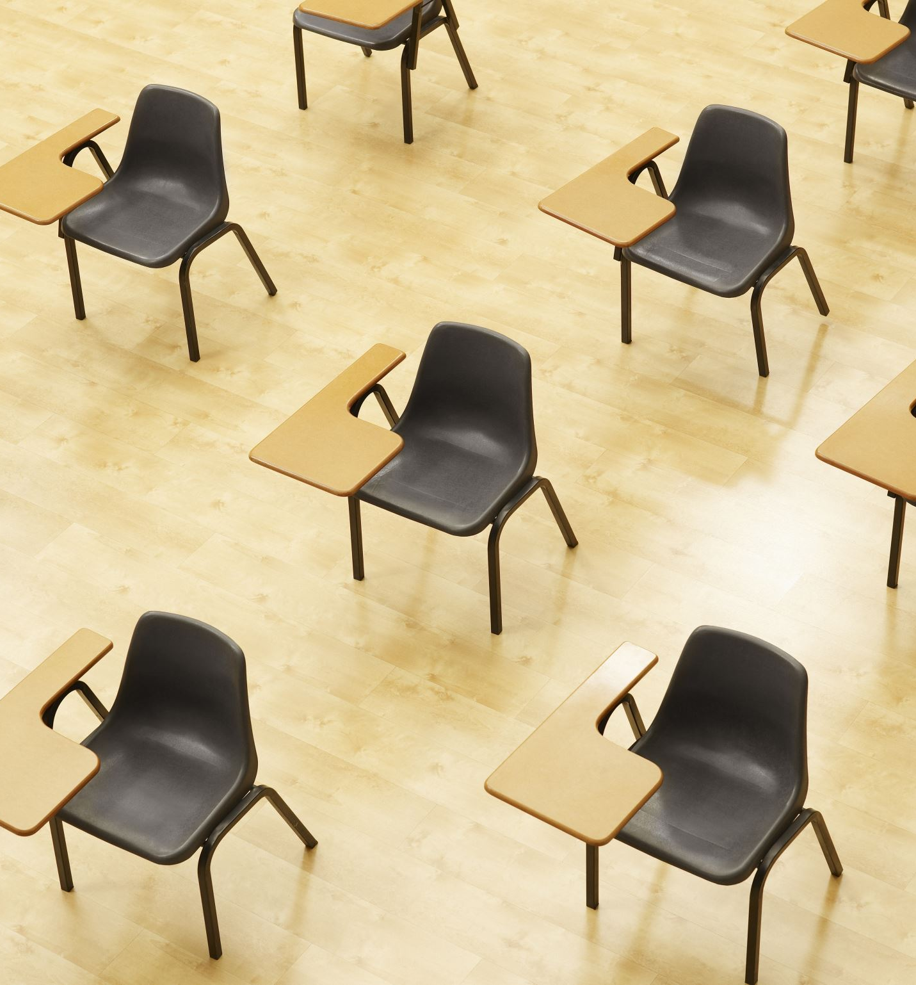
Expectations (cont’d)
Social distancing is expected and will always be enforced in the classroom.
Students are STRONGLY encouraged to wear a mask.
No eating or drinking in the classroom except for breakfast (before school) and during the class assigned lunch time.
Back to
Ready to get started

